Slide 1
Class Title
<Date of Presentation>
<Presenter’s Name>
Notes:
Enter class title. Note for class titles: it should follow the format of “Application, Role, OR Major Initiative – Topic”.
Examples:
Electronic Health Record (EHR) – Updates in V1.1 p37
RPMS Administrator – Device Management
STI Syndemic – Syphilis Health Summary Report
Fill in information in brackets and delete brackets.
If the list of presenters is long, this can be omitted to keep the title slide clean.

Slide 2
Learning Objectives
By the end of this training, you will be able to:
<enter objective #1>
<enter objective #2>
<etc.>
Notes:
Example objectives
At the end of this lesson, you will be able to:
Save files to the team Web server.
Move files to different locations on the team Web server.
Share files on the team Web server.

Slide 3
Slide Title
<Insert lecture and/or demonstration notes.>
<Add additional slides as needed.>
Notes:
If you have multiple slide titles with the same name, add numbers to differentiate (see next two slides).
Use proper capitalization for titles (i.e. the first letter of most words should be caps).
Example:
Create TIU Notes (1) and Create TIU Notes (2).

Slide 4
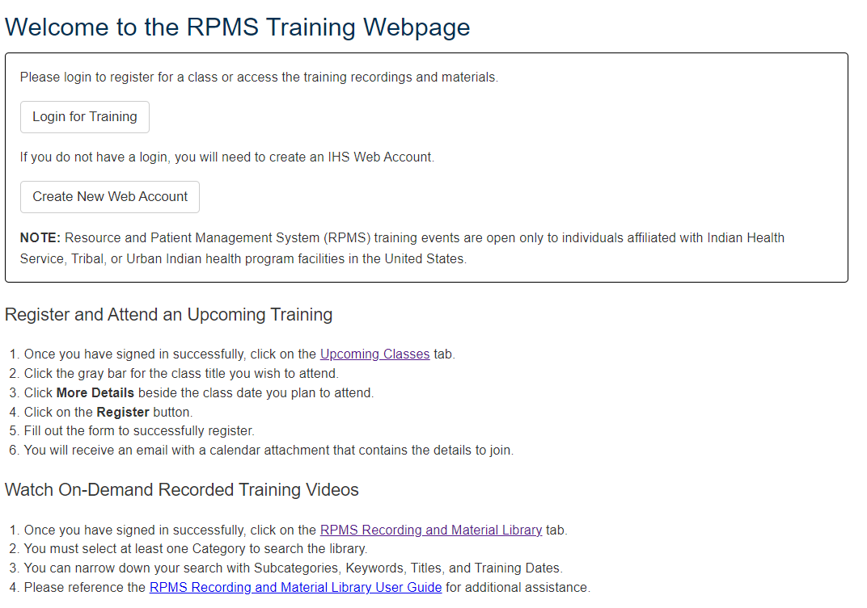
Content with Graphic Example (1)
<Insert lecture and/or demonstration notes.>
Notes:
Bullets on left; screenshot on right.

Slide 5
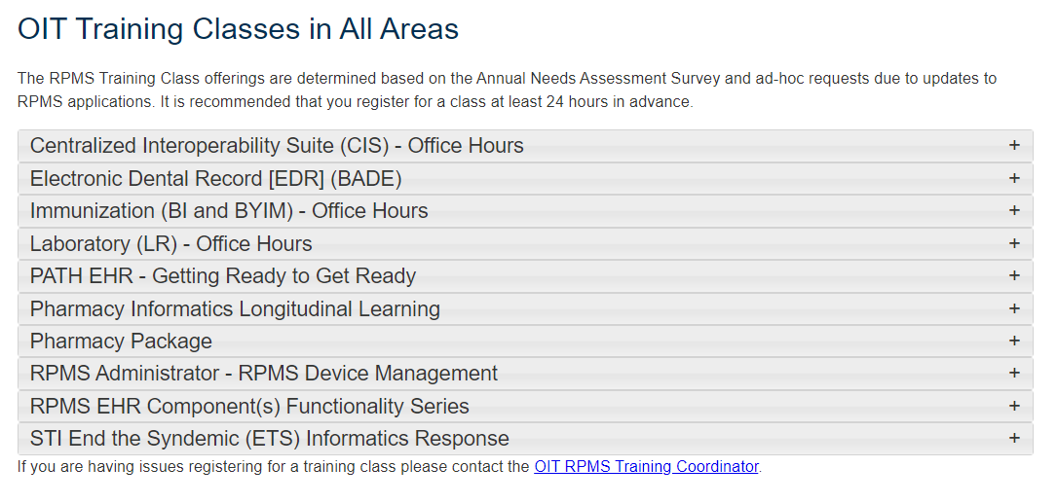
Content with Graphic Example (2)
<Insert lecture and/or demonstration notes.>
Notes:
Bullets on left; screenshot on right.

Slide 6
Knowledge Check
<Insert a few questions to test student learning and comprehension. List in number format and directly align with the objectives.>
Notes:
Be creative and use different types such as matching, multiple choice, fill in the blank, explain in your own words, etc.
Ask participants to type their answers in the chat.

Slide 7
Resources
RPMS Training Webpage: https://www.ihs.gov/rpms/training/
RPMS Recording and Material Library: https://www.ihs.gov/rpms/training/recording-and-material-library/
Email the RPMS Training Team: RPMSTraining@ihs.gov
Enter a training request: https://ihsitsupport.servicenowservices.com/sp

Slide 8
Questions & Discussion
Notes:
Open it up to questions and discussion.

